Slide 1
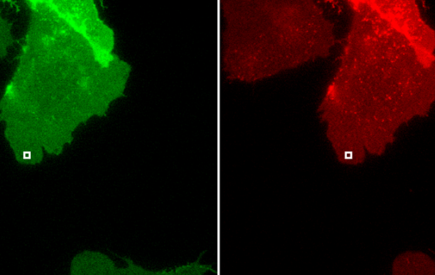
Single-molecule FRET imaging of GPCR dimers in living cells
Marie Van Rossum, Tingzhen Li, Lorraine Cordonnier
smFRET for GPCR dimers inn cells / CH-312
Wesley B.Asher et al.
April 2021
Nature Methods

Slide 2



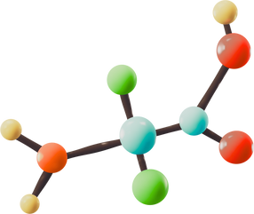
What are GPCR’s ?
  GPCRs = large family of 7-transmembrane proteins (~800 members)
  Involved in signaling: vision, smell, neurotransmission, hormones
Marie, Tingzhen, Lorraine
 | Class A | Class B | Class C
Structure | Short N-terminus | Large extracellular domain | Large extracellular Venus Flytrap (VFT) domain
Ligand | Small molecules (neurotransmitters) | Peptide hormones | Small molecules (GABA-receptors)
Dimerization | Mostly monomers | Uncertain | Obligatory dimers

Slide 3



Why previous methods fall short
Diffraction-Limited Imaging
  Resolution >250 nm → can't detect <10 nm interactions
  Fails to distinguish dimers from nearby monomers
Marie, Tingzhen, Lorraine
Ensemble Averaging (FRET)
  Signals averaged over many molecules
  Masks transient or rare interactions
Single-Particle Tracking (SPT)
  Measures diffusion only
  Cannot confirm receptor–receptor binding

Slide 4
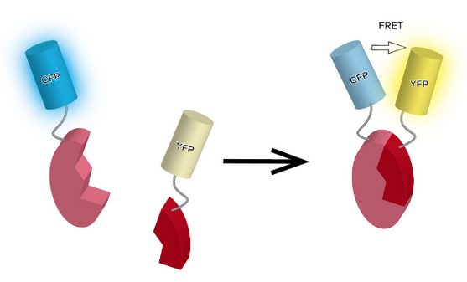
What is smFRET?
  smFRET measures nanometer-scale distances between fluorophores
  Principle: excite donor → energy may transfer to acceptor → acceptor emits fluorescence
Marie, Tingzhen, Lorraine
  FRET efficiency ∝ proximity (<10 nm)
  Enables detection of dimerization, conformational change, dynamics
  Single-molecule resolution avoids ensemble averaging

Slide 5
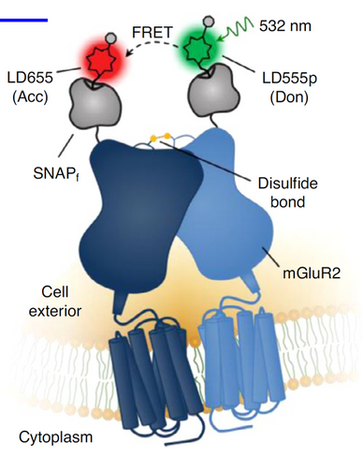
How can smFRET detect single molecules?
  Low expression + TIRF excitation + trajectory validation
  SNAPf + inducible system controls expression to ~0.3 molecules/μm².
  SNAPf is a fast-reacting variant of the SNAP-tag that enables covalent, site-specific labeling of proteins using benzylguanine-conjugated dyes for applications like smFRET.
  TIRF microscopy excites only the membrane-adjacent 100 nm layer.
  Strong reduction in background fluorescence from cytoplasmic fluorophores.
  Single-step photobleaching trajectories confirm isolated molecules.
Marie, Tingzhen, Lorraine

Slide 6
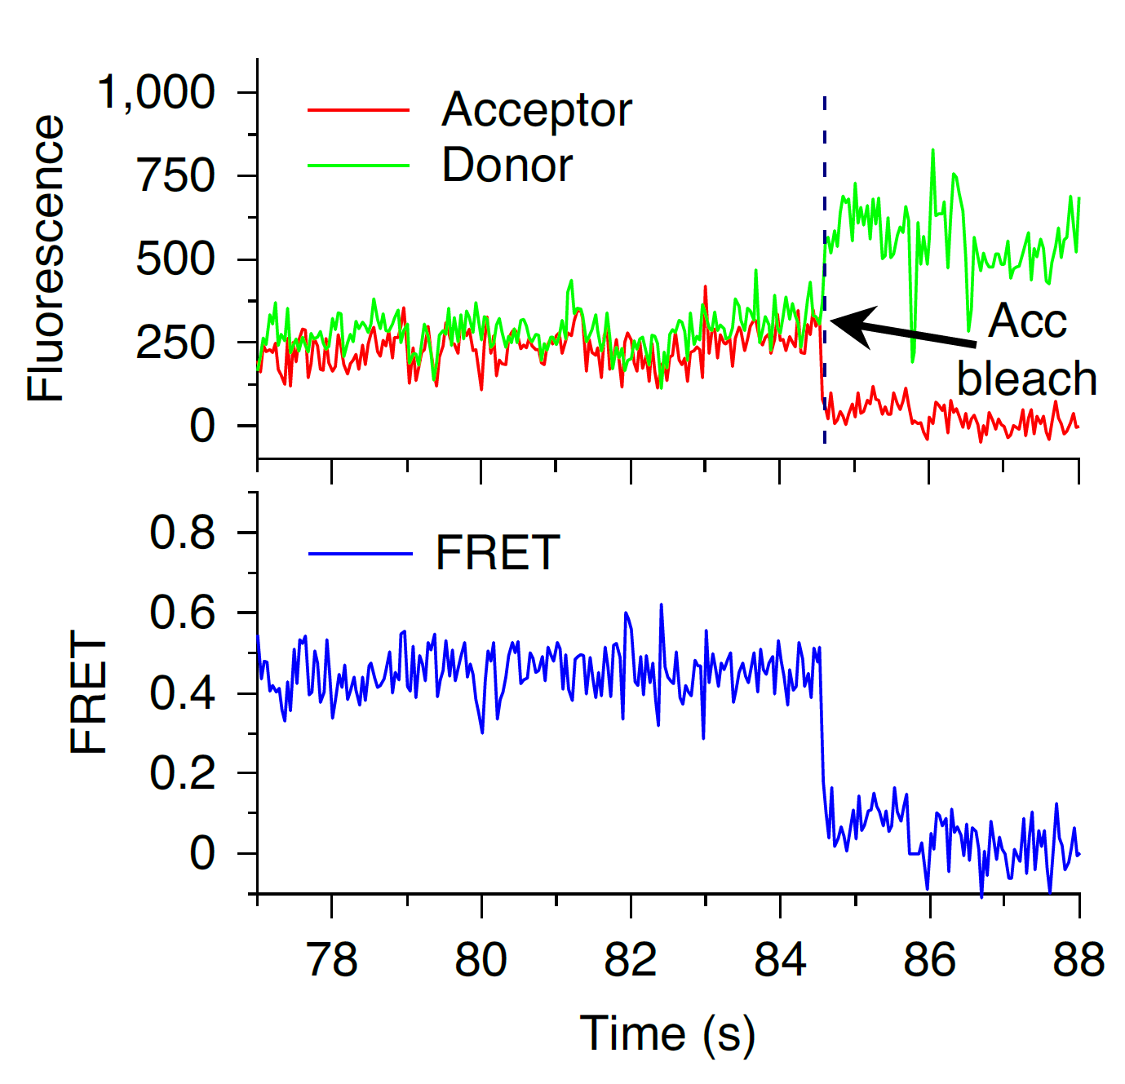
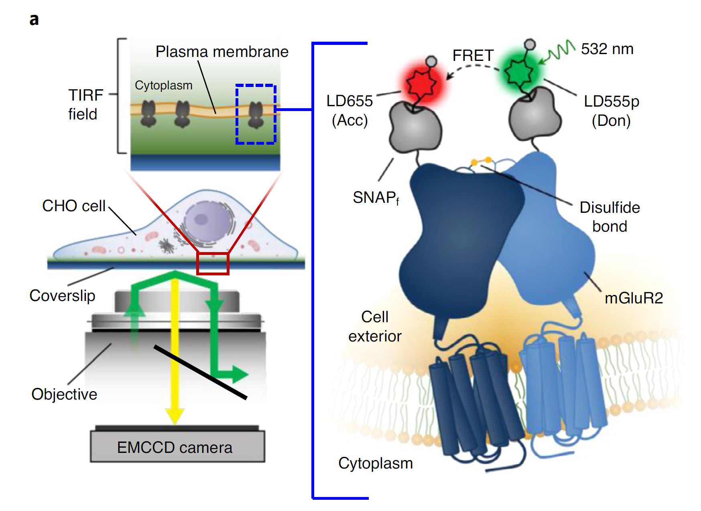
Detecting Protein Interactions via smFRET
Marie, Tingzhen, Lorraine
Donor signal rebound
FRET drop
TIRF allows low-background single-molecule imaging
FRET occurs only when donor–acceptor are <10 nm
Trajectories reveal real-time molecular dynamics
Notes:
This is what a typical smFRET trajectory looks like.
You can see the donor intensity increases right after the acceptor photobleaches—this is a classic anti-correlated signal, which confirms that the two fluorophores are within 10 nm, and part of the same complex.
This trajectory shows a classic anti-corr
This is a representative smFRET trajectory of a single mGluR2 complex.
We can clearly see that the acceptor fluorescence (red) suddenly drops—this indicates photobleaching.
Right after that, the donor (green) signal increases, since energy is no longer transferred.
At the same time, FRET efficiency (blue) drops sharply.
This anti-correlated bleaching is strong evidence that the two fluorophores were within 10 nm—confirming they were part of a real dimer.elated photobleaching event, where the acceptor disappears and the donor intensity recovers, confirming they were close enough for FRET.

Slide 7
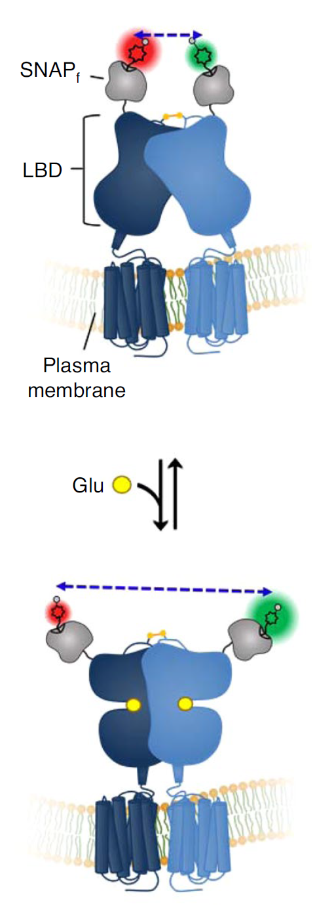
Why mGluR2?
A Benchmark for smFRET Validation
Marie, Tingzhen, Lorraine
SNAP-tag labeling site for donor/acceptor dye
FRET pair: LD555p (green donor), LD655 (red acceptor)
Glu
Apo state:
LBDs close together
→ high FRET efficiency
Holo (Glutamate-bound) state:
LBDs swing apart
→ low FRET efficiency
Class C GPCR obligate homodimer
Disulfide bond links extracellular domains
LBD undergoes large-scale rearrangement upon ligand binding
Ideal model to test smFRET resolution for real structural change
Notes:
“To validate smFRET, we need a GPCR that we know forms dimers and undergoes structural change.
mGluR2 is a class C GPCR that exists as a stable homodimer, even without ligand.
Its extracellular LBD domains are covalently linked by disulfide bonds, so they're always physically close.
But upon binding glutamate, these LBDs swing apart—creating a large distance change that should be visible via smFRET.”
“In the figure, you can see that in the apo state, the two LBDs are close together—allowing high FRET efficiency.
After ligand binding, they move apart—FRET should drop.
So if our technique is working, we should detect this shift.”

Slide 8
Why Use Donor : Acceptor = 1:2 Labeling Ratio?
Maximizes informative Don–Acc pairs while minimizing Don–Don background
Random labeling produces Don–Don, Acc–Acc, and Don–Acc pairs.
Only Don–Acc dimers generate usable smFRET signals.
1:1 ratio gives the highest Don–Acc (50%) in theory. But acceptor signal is weaker and photobleaches faster in practice.
1:2 ratio increases Don–Acc yield (44%) and reduces Don–Don (11%).
Marie, Tingzhen, Lorraine
Effect of Don.: Acc. Ratio Change of pair formation
1:1 ratio
1:2 ratio
Desired
Don.- Acc.
★
Slight decrease of Don.- Acc.
★
Undesired Don.- Don.
Less
Don.- Don.
Notes:
“Not all FRET fluctuations indicate structural changes.
On the left, we see donor and acceptor intensities fluctuate in sync—FRET remains relatively constant.
This is likely due to drift or small-scale motion, not a real conformational change.
On the right, however, the donor and acceptor signals decorrelate.
FRET changes independently, indicating real structural transitions between states.
This analysis confirms that the observed jumps are not artifacts but reflect biologically relevant dynamics.”

Slide 9
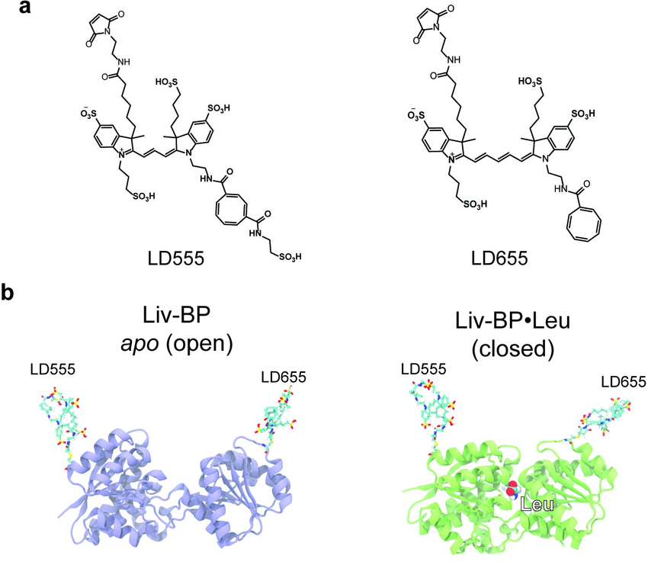
Why Use Self-Healing Dyes in smFRET?
Marie, Tingzhen, Lorraine
LD555p (donor) and LD655 (acceptor) are proprietary self-healing dyes for single-molecule imaging.
Their structures include radical-scavenging groups that reduce ROS, limiting photobleaching.
This greatly extends dye lifetime: in Asher et al. (2021), LD555p lasted ~51 s, LD655 ~19 s.
Longer lifetimes enable fuller trajectories, stronger statistics, and fewer lost FRET events.
Notes:
“Not all FRET fluctuations indicate structural changes.
On the left, we see donor and acceptor intensities fluctuate in sync—FRET remains relatively constant.
This is likely due to drift or small-scale motion, not a real conformational change.
On the right, however, the donor and acceptor signals decorrelate.
FRET changes independently, indicating real structural transitions between states.
This analysis confirms that the observed jumps are not artifacts but reflect biologically relevant dynamics.”

Slide 10
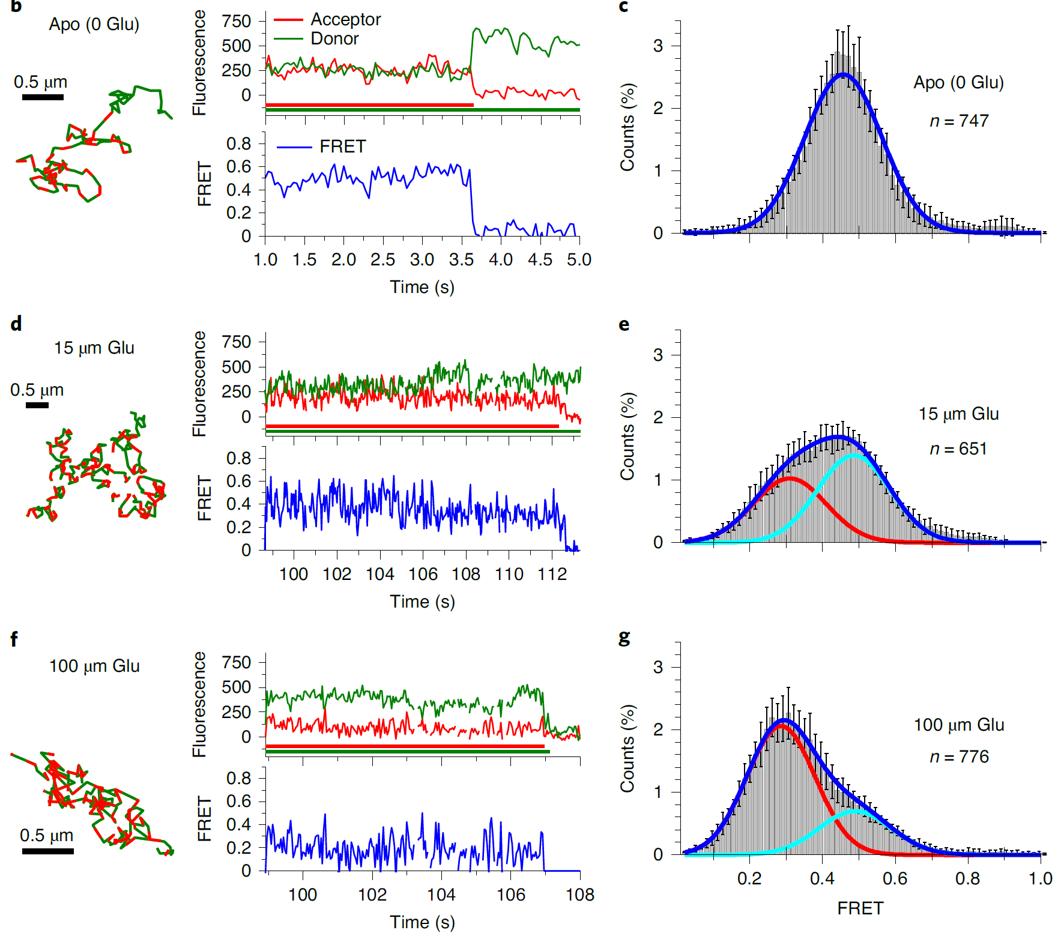
Single-Molecule Trajectories Reveal Dynamic Switching
Acc. bleach
Marie, Tingzhen, Lorraine
FRET is validated by anticorrelated donor–acceptor intensity shifts:
Acceptor bleaching stops energy transfer;
Donor signal rebounds, acceptor drops to zero;
FRET efficiency collapses → diagnostic “jump”.
This intensity shift is a signature of true smFRET.
⚠️ Donor bleaching disables both signals → cannot confirm FRET.
Notes:
Once we confirmed mGluR2 forms dimers, we asked: can smFRET detect its structural rearrangement upon ligand binding?
In these FRET efficiency histograms, we can clearly see the answer is yes.
In the absence of glutamate, most FRET values are high—centered around 0.46.
When we add 15 micromolar glutamate, the distribution broadens and begins to shift.
At 100 micromolar, the distribution fully shifts to a lower peak around 0.29.
This confirms that the LBD domains move apart after ligand binding—just as expected from structural models.

Slide 11

Population-Level Conformational Shift upon Ligand Binding
Marie, Tingzhen, Lorraine
smFRET histograms show glutamate-dependent structural changes
Apo receptors display a single high-FRET state (~0.46)
Low-dose glutamate introduces a second, lower FRET population
High-dose glutamate shifts the dominant population to ~0.29
These results support a two-state conformational model
High FRET → LBDs close
Intermediate shift
Low FRET → LBDs apart
Holo
Apo
$$E=\frac{I_{A}}{I_{D}+I_{A}}$$
Notes:
Once we confirmed mGluR2 forms dimers, we asked: can smFRET detect its structural rearrangement upon ligand binding?
In these FRET efficiency histograms, we can clearly see the answer is yes.
In the absence of glutamate, most FRET values are high—centered around 0.46.
When we add 15 micromolar glutamate, the distribution broadens and begins to shift.
At 100 micromolar, the distribution fully shifts to a lower peak around 0.29.
This confirms that the LBD domains move apart after ligand binding—just as expected from structural models.

Slide 12
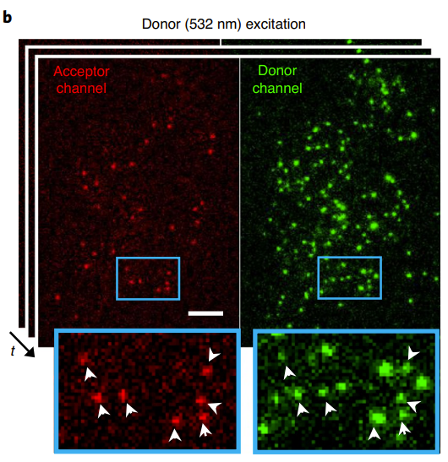
Photobleaching Confirms smFRET from Individual Dimers
Marie, Tingzhen, Lorraine
Single-step photobleaching confirms individual molecules
Anticorrelated donor/acceptor signals validate true FRET
Donors without colocalized acceptors show no FRET
Confirms that smFRET arises from mGluR2 dimers
Notes:
Once we confirmed mGluR2 forms dimers, we asked: can smFRET detect its structural rearrangement upon ligand binding?
In these FRET efficiency histograms, we can clearly see the answer is yes.
In the absence of glutamate, most FRET values are high—centered around 0.46.
When we add 15 micromolar glutamate, the distribution broadens and begins to shift.
At 100 micromolar, the distribution fully shifts to a lower peak around 0.29.
This confirms that the LBD domains move apart after ligand binding—just as expected from structural models.

Slide 13
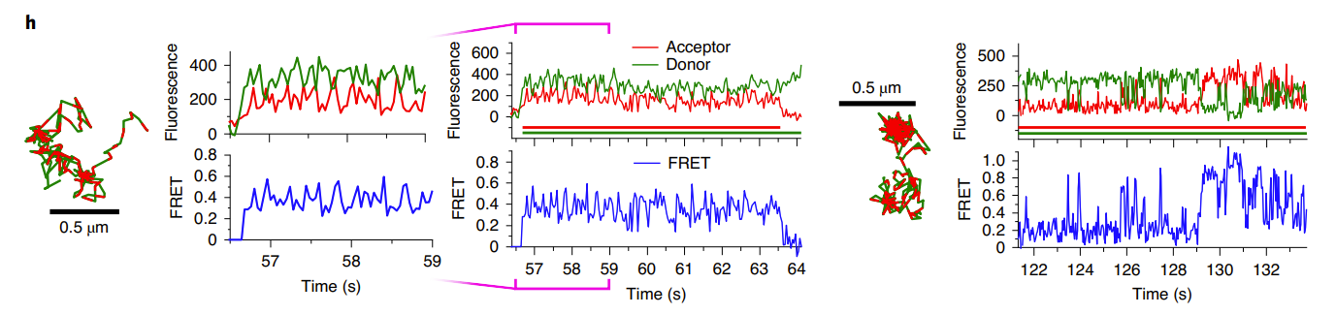
Correlation Analysis Confirms Real Conformational Transitions
Marie, Tingzhen, Lorraine
Correlated donor–acceptor signals suggest movement artifacts
Decorrelated signals with FRET jumps reflect true conformational switching
This validates the smFRET trajectory as structurally meaningful
Donor and acceptor fluctuate together
FRET remains stable
Interpretation: movement, not conformational change
Donor and acceptor decorrelated
FRET fluctuates independently
Interpretation: real switching between conformations
Correlated signal → likely drift
Decorrelated signal →
real conformational switching
FRET state change
Notes:
“Not all FRET fluctuations indicate structural changes.
On the left, we see donor and acceptor intensities fluctuate in sync—FRET remains relatively constant.
This is likely due to drift or small-scale motion, not a real conformational change.
On the right, however, the donor and acceptor signals decorrelate.
FRET changes independently, indicating real structural transitions between states.
This analysis confirms that the observed jumps are not artifacts but reflect biologically relevant dynamics.”

Slide 14
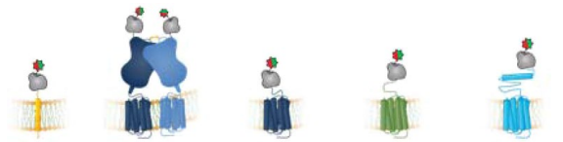
Quick recap and follow-up
Marie, Tingzhen, Lorraine
smFRET : reveals stable dimerization and conformational switching in mGluR2 (class C GPCR)
NLT, FDT methods : capture dynamic interactions on different timescales.
How can we uncover the dimerization behavior of less-characterized GPCRs, particularly those from class A and B?
Expression level varies dramatically across tissues : could it control whether or not dimerization happens?

Slide 15
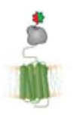



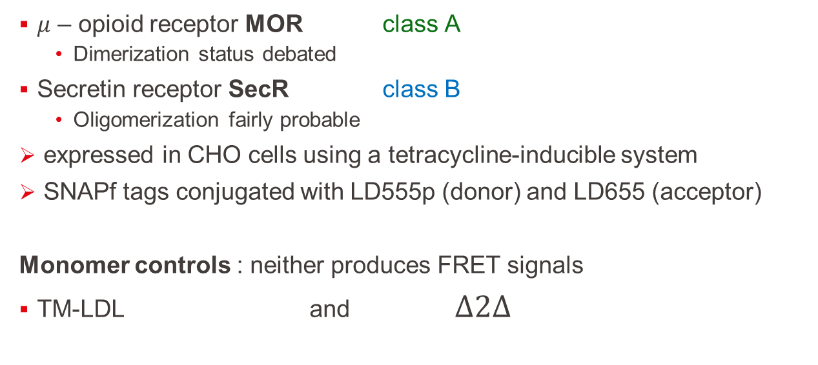
Receptors and monomer controls
Marie, Tingzhen, Lorraine
$μ$ – opioid receptor MOR class A
  Dimerization status debated
Secretin receptor SecR class B
  Oligomerization fairly probable
expressed in CHO cells using a tetracycline-inducible system
SNAPf tags conjugated with LD555p (donor) and LD655 (acceptor)
Monomer controls : neither produces FRET signals
TM-LDL and $Δ2Δ$

Slide 16
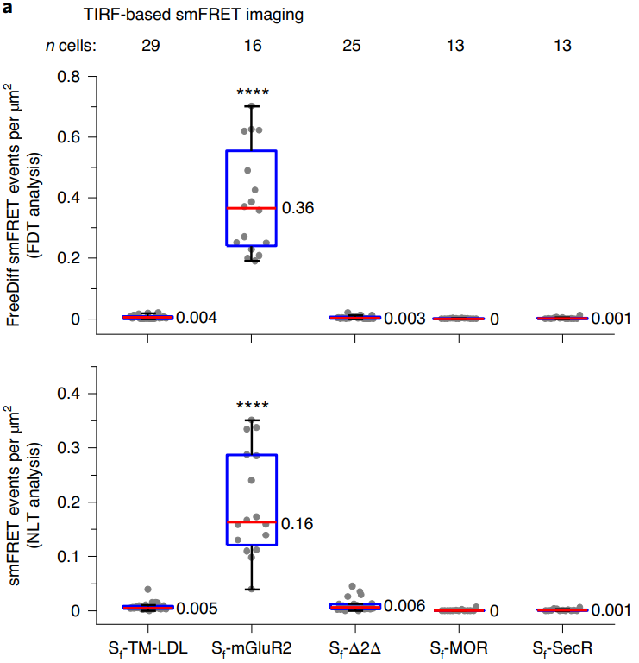


Characterizing smFRET for monomer controls and prototypical class A and B GPCRs
FDT
Marie, Tingzhen, Lorraine
S_{f} -MOR and S_{f} -SecR do not from long-lived dimers at low surface densities
Are receptor interactions detectable at higher expression?
NLT

Slide 17
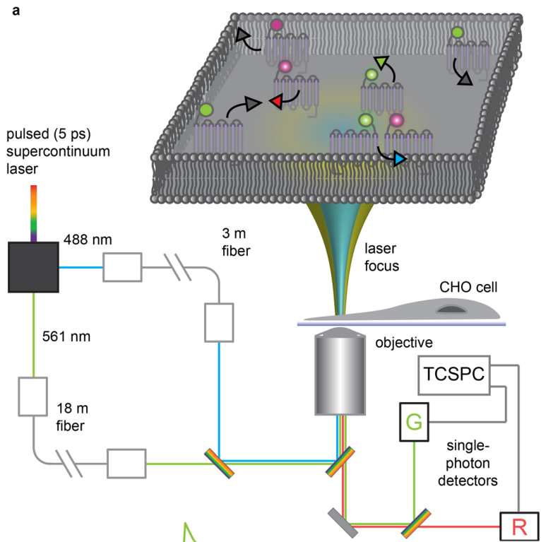
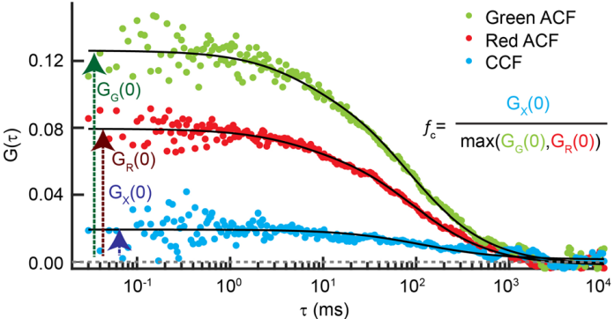
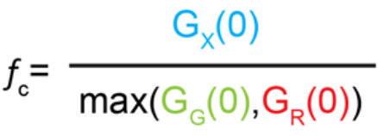
Evaluating receptor dimerization at high receptor densities using PIE-FCCS
Pulsed Interleaved Excitation Fluorescence Cross-Correlation Spectroscopy
Marie, Tingzhen, Lorraine
TCSPC = time correlated single photon counting device

Slide 18
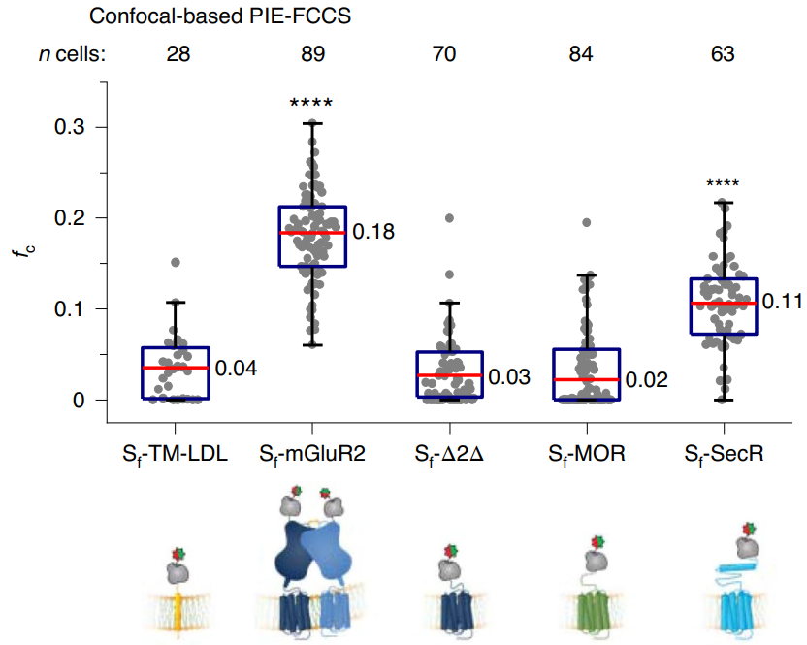


Evaluating receptor dimerization at high receptor densities using PIE-FCCS
Marie, Tingzhen, Lorraine
strong indicator that, at high surface densities :
  S_{f} -SecR forms dimers
  S_{f} –MOR remains monomeric
further work needed to verify that co-diffusion observed via PIE-FCCS truly reflects nanometer-scale interactions

Slide 19
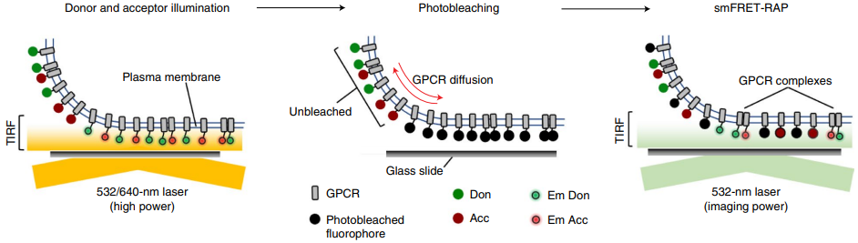

Tracking receptor complexes by smFRET at high expression levels : smFRET-RAP
Single-molecule FRET coupled with FRAP (fluorescence after photobleaching recovery)
Marie, Tingzhen, Lorraine
fluorophores receive high intensity illumination
their fluorescence lifetime quickly elapses

Slide 20
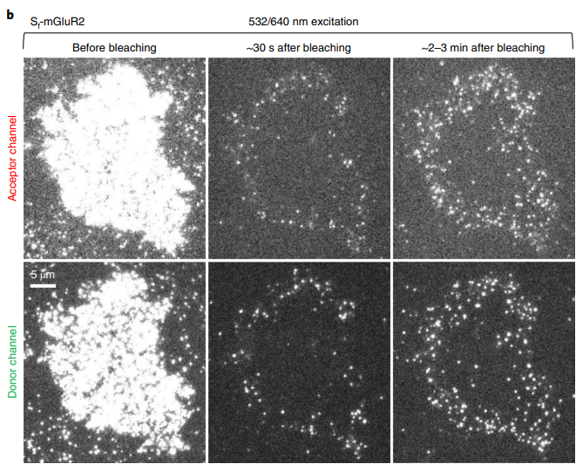
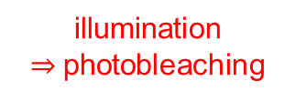


Tracking receptor complexes by smFRET at high expression levels : smFRET-RAP
illumination
$⇒$photobleaching
smFRET after recovery
Marie, Tingzhen, Lorraine
diffusion

Slide 21
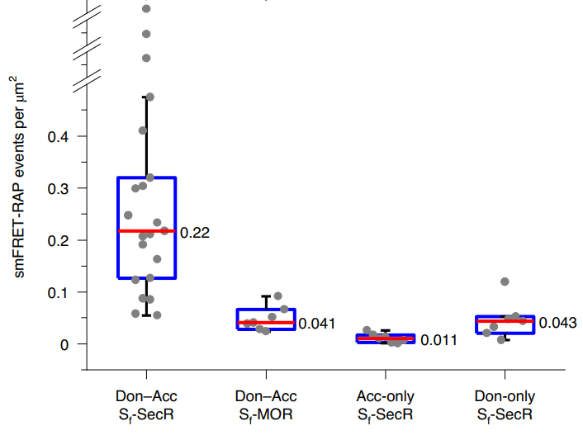
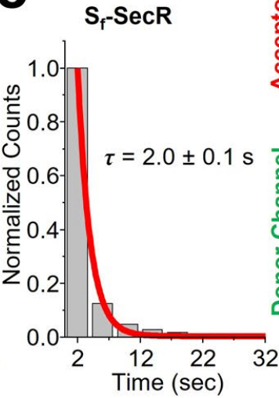


Tracking receptor complexes by smFRET at high expression levels
Sensitized acceptors
NLT
Marie, Tingzhen, Lorraine
MOR does not dimerize at high receptor density
SecR does dimerize
  and individual SecR protomers remain assembled for at least as long as can be measured by smFRET approach

Slide 22
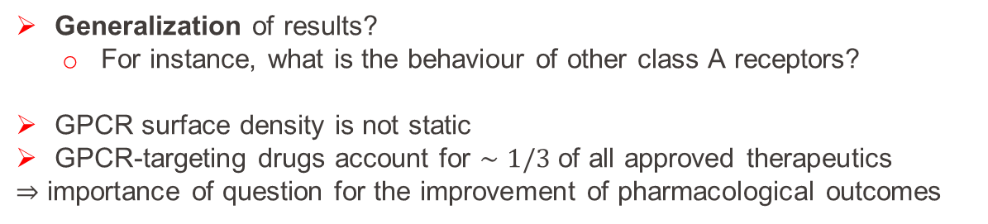
Summary and Outlook
Leverage single-molecule FRET to detect and track TM proteins diffusing within plasma membrane of mammalian cells
Find evidence of at least 3 dimerization modes across GPCR classes:
  Constitutive dimers (like mGluR2, class C)
  Density-dependent dimers (like SecR, class B)
  Non-dimerizing monomers (like MOR, class A)
Marie, Tingzhen, Lorraine
Generalization of results?
  For instance, what is the behaviour of other class A receptors?
GPCR surface density is not static
GPCR-targeting drugs account for $∼1/3$ of all approved therapeutics
$⇒$ importance of question for the improvement of pharmacological outcomes

Slide 23
Questions
Marie, Tingzhen, Lorraine
How might the dimerization state of a GPCR influence drug efficacy or side-effect profiles?
How was the labeling site on the protein selected in this study?
Given that SecR shows density-dependent dimerization, how might its behavior change in a context where receptor expression is upregulated (cancer, chronic inflammation)?
What are the limitations of smFRET and PIE-FCCS in studying GPCR organization? How could future technologies or in vivo models overcome them?
Thank you!

